Slide 1


Customer Behviour
Shopping Analysis
Rhoda Innocent,
Data Analyst

Slide 2

Table of
Contents
Executive Summary
Business Introduction
Methodology
Key Business Insights
Interactive Dashboard
Discussion
Recommendations
Conclusion

Slide 3
Executive Summary
This report analyzes 3,000 customer shopping transactions to identify purchasing trends and opportunities to improve customer engagement, sales, and retention. The analysis examines customer demographics, product categories, discounts, subscriptions, and shopping behavior using Python, MySQL, and Power BI.
The findings show that clothing generated the highest sales, subscription customers spent more on average, and discounts significantly influenced purchasing decisions. Customer segmentation also revealed opportunities to improve retention and increase repeat purchases.
Based on these insights, the company should strengthen loyalty programs, promote high-performing products, and implement targeted marketing strategies to drive revenue growth and enhance customer satisfaction.

Slide 4
Business Introduction
Customer data provides valuable insights into how people shop and what influences their buying decisions.
This report examines these patterns to help the business improve marketing strategies, strengthen customer loyalty, and increase revenue.

Slide 5
Methodology
Data Source
Customer Shopping Behaviour Dataset (3,000 customer transactions)
Data Collection
Data was collected from a publicly available customer shopping dataset in CSV
Data Preparation:
The dataset underwent several preprocessing steps:
Handling missing values
Renaming columns for consistency
Feature engineering (Age Group and Purchase Frequency)
Removing redundant columns
Loading the cleaned dataset into MySQL for SQL analysis

Slide 6
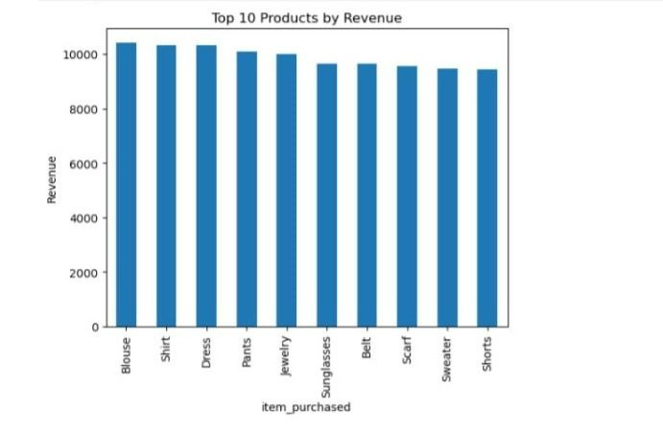
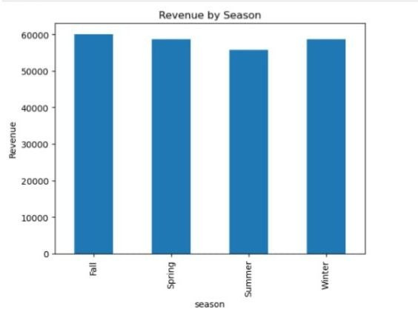
Key Business Insights
Blouse, shirt, dress, pant, jewelry, generated the most revenue
Fall season has the most revenue, along side winter and spring

Slide 7
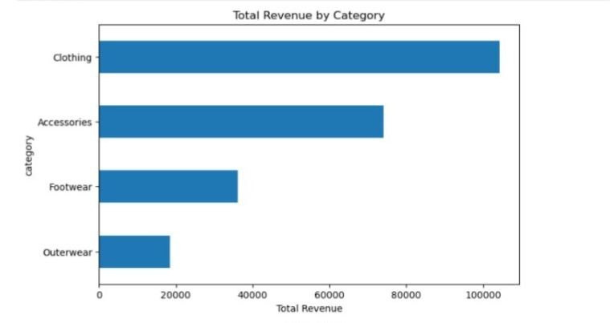
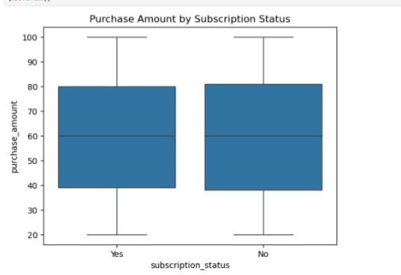
Key Business
Insights
Both subscription status(yes/no) shows same median, quartile, interquartile range
Clothing category generated the most revenue

Slide 8
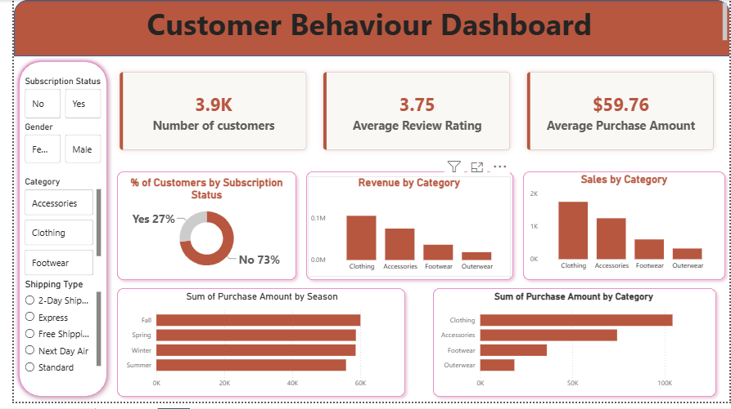

Slide 9
Discussion
Insights & Strategy
Customer spending is influenced by demographics, subscriptions, and product preferences.
Loyalty programs encourage higher spending and repeat purchases.
Top-performing products and customer segments provide opportunities for targeted marketing.
Data-driven decisions can improve customer engagement, retention, and long-term business growth.

Slide 10
Recommendations
Leverage the high-performing Clothing category to drive revenue by cross-selling complementary products.
Increase customer retention through targeted lifecycle marketing that encourages repeat purchases.
Develop marketing campaigns tailored to female customers, who represent a high-value customer segment.
Promote top-selling products in each category as featured items across the website, advertising campaigns, and search results.
Strengthen customer loyalty by offering exclusive rewards, early access, and referral incentives to loyal customers.
Convert new and returning customers into loyal buyers using personalized post-purchase emails, product recommendations, and progressive rewards.
Prioritize high-value customer segments, including high-revenue age groups and express-shipping customers, with targeted promotions and personalized offers.

Slide 11

Conclusion
This analysis revealed key patterns in customer behavior, product performance, and purchasing trends that can support smarter business decisions. By applying these insights, the company can improve customer loyalty, optimize marketing efforts, increase revenue, and drive long-term business growth.
Rhoda Innocent,
Data Analyst
innocentrhoda54@gmail.com
+2348169818758

